Slide 1
Latent Dirichlet Allocation (LDA) on News Dataset
Diksha Bhushan Waghmare
BugendaiTech Data Science Intern
Team Ayush

Slide 2
News Data
ABC (Australian Broadcasting Corp.) was downloaded from Kaggle. The data cleanup was performed on it and we will use LDA ( Latent Dirichlet Allocation) method to model the topics from these headlines. LDA assumes that each headline is taken from a number of topics and each topic consists of several words. A few steps are listed below
Extract the topics from a million news headlines sourced from the reputable Australian news source ABC (Australian Broadcasting Corp.).
Data was imported and then perform EDA.
Number of words in a year, month, and day field to see the distribution of headlines.
Build a word cloud to see the most frequent words that are being used in the headlines over the years.
Visualized the top 15 words used with their frequencies.
Perform Clustering using LDA ( Latent Dirichlet Analysis)
Different documents belong to their cluster from the TSNE plot.

Slide 3
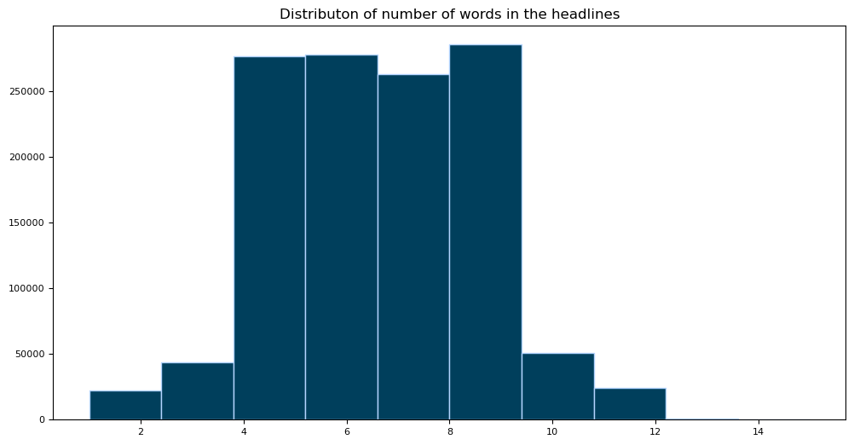
Distribution of the number of words in the headlines news
We can see that most of the headlines have around 4-6 words

Slide 4
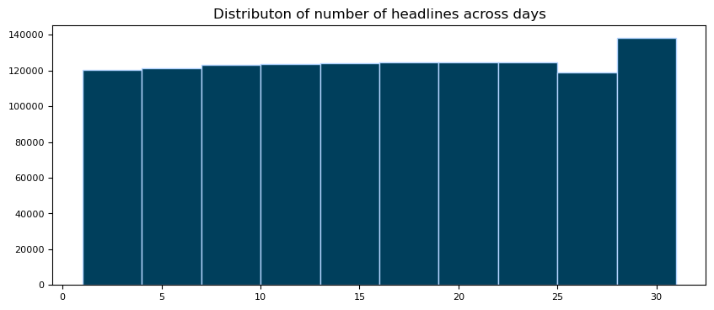
Distribution of the number of words in the headlines across days
It Seems like the distribution is uniform across the days.

Slide 5
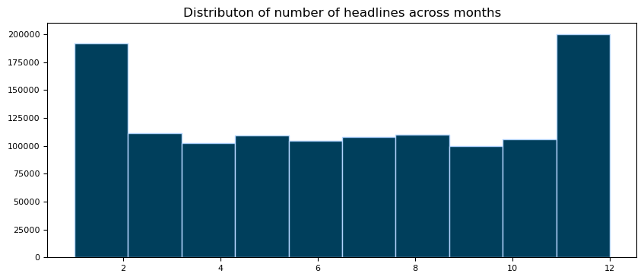
Distribution of the number of words in the headlines across Months
The start and the end of the year have contributed to most of the headlines in the dataset.

Slide 6
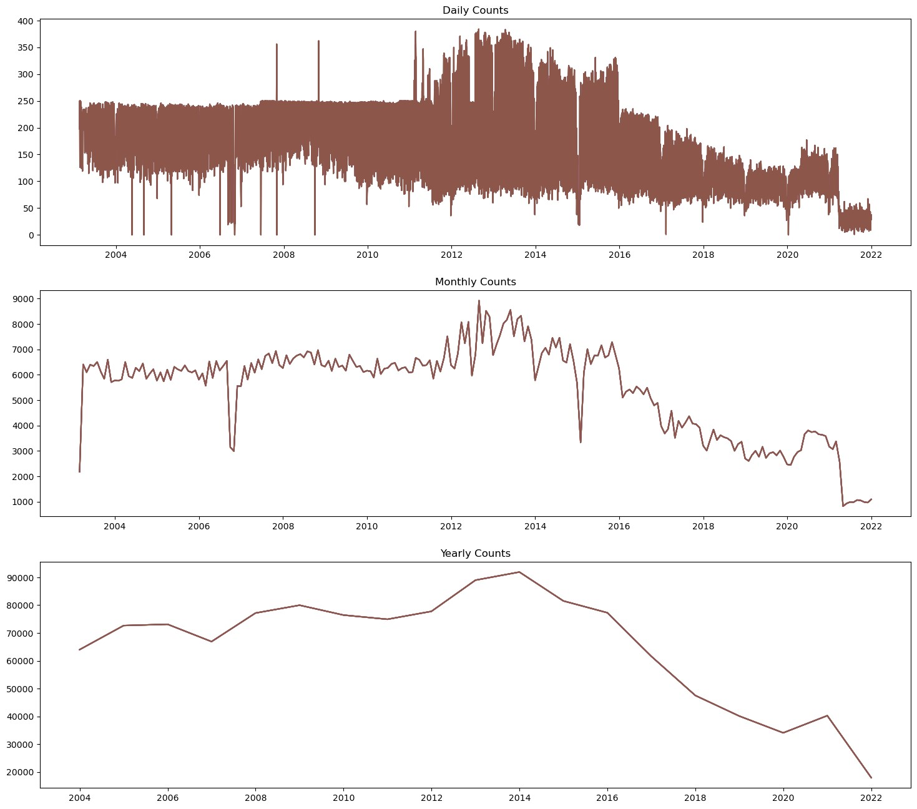
Visualize in a time-series pattern
Visualize in a time-series pattern to see the everyday changes in the number of headlines.
This will give us a better intuition and will be interesting to think about all the reasons that could have contributed to the spike during some years
It can also get a sense of the sample density.

Slide 7
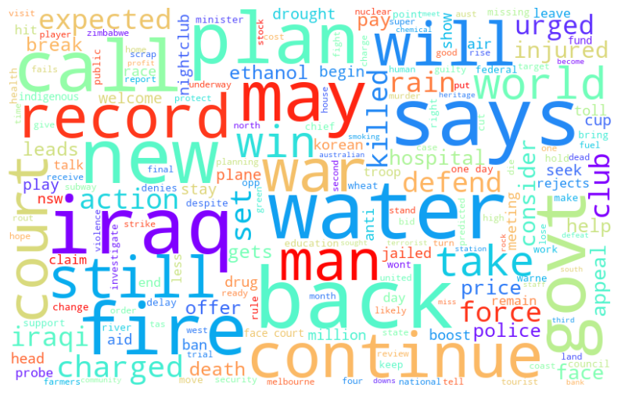
Wordcloud to see the most frequent words
The word cloud seems so interesting. Inspite of the news channel belonging to Australia, we can see some frequent words like ‘Iraq' and some other words like ‘Water', ‘govt', ‘fire', ‘war', etc.
.

Slide 8
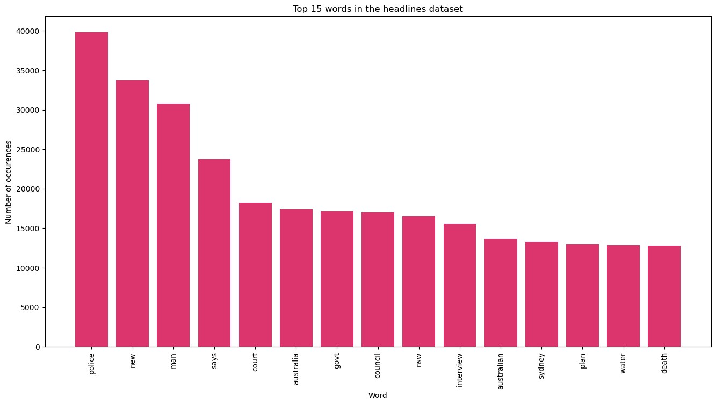
Top words frequency
The frequency of words is visualized in bar charts. We can observe that “Police” word has the highest occurrence of words whereas death, water, plan & Sydney has the lowest.

Slide 9
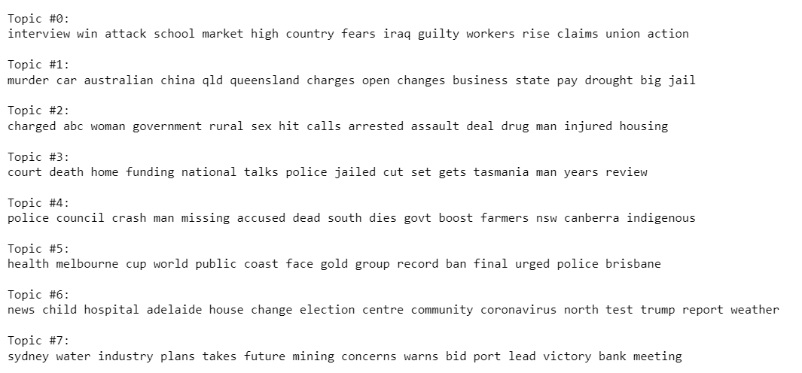
Topics found via LDA
The following topics found via LDA

Slide 10
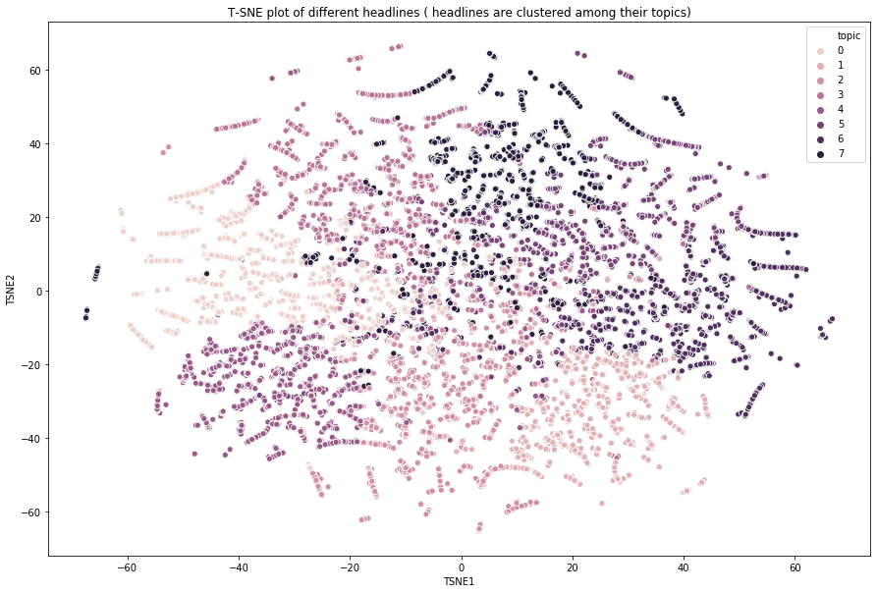
T-SNE plot of different headlines
T-distributed neighbor embedding (t-SNE) is a dimensionality reduction technique that helps users visualize high-dimensional data sets. We can see how different documents belong to their cluster from the TSNE plot.

Slide 11
Thank You

